Slide 1
Lecture 6. Node.js/Express. API

Slide 2
Introduction
The Express website describes Express as “a minimal and flexible node.js web application framework, providing a robust set of features for building single and multipage and hybrid web applications.”
Minimal. This is one of the most appealing aspects of Express. Many times, framework developers forget that usually “less is more.” The Express philosophy is to provide the minimal layer between your brain and the server. It means that it gets in your way less, allowing you full expression of your ideas, while at the same time providing something useful.
Flexible. Another key aspect of the Express philosophy is that Express is extensible. Express provides you a very minimal framework, and you can add in different parts of Express functionality as needed, replacing whatever doesn’t meet your needs.
Web application framework Does that mean you can’t build a website or web pages with Express? No, a website is a web application, and a web page is a web application. But a web application can be more: it can provide functionality to other web applications (among other things).
In general, “app” is used to signify something that has functionality: it’s not just a static collection of content.
Single-page web applications Instead of a website requiring a network request every time the user navigates to a different page, a single-page web application downloads the entire site (to the client’s browser. After that initial download, navigation is faster because there is little or no communication with the server.
Multipage and hybrid web applications Multipage web applications are a more traditional approach to websites. Each page on a website is provided by a separate request to the server. There are simply more options now, and you can decide what parts of your content should be delivered as a single-page app, and what parts should be delivered via individual requests. “Hybrid” describes sites that utilize both of these approaches

Slide 3
Express web framework (Node.js/JavaScript)
Express is a popular Node web framework written in JavaScript and running inside the node runtime environment.js.
This module highlights some of the key benefits of this framework, the installation of the development environment and the execution of the main tasks of web development and deployment.
It provides mechanisms to:
Write handlers for requests with different HTTP verbs at different URL paths (routes).
Integrate with "view" rendering engines in order to generate responses by inserting data into templates.
Set common web application settings like the port to use for connecting, and the location of templates that are used for rendering the response.
Add additional request processing "middleware" at any point within the request handling pipeline.

Slide 4
The popularity of a web framework is important because it is an indicator of whether it will continue to be maintained, and what resources are likely to be available in terms of documentation, add-on libraries, and technical support.
There isn't any readily-available and definitive measure of the popularity of server-side frameworks (although you can estimate popularity using mechanisms like counting the number of GitHub projects and StackOverflow questions for each platform).
Whether Node and Express are "popular enough" to avoid the problems of unpopular platforms?
Based on the number of high profile companies (statistic) that use Express, the number of people contributing to the codebase, and the number of people providing both free and paid for support, then yes, Express is a popular framework.

Slide 5
Express is unopinionated
Web frameworks often refer to themselves as "opinionated" or "unopinionated".
Opinionated frameworks are those with opinions about the "right way" to handle any particular task.
They often support rapid development in a particular domain (solving problems of a particular type) because the right way to do anything is usually well-understood and well-documented.
However they can be less flexible at solving problems outside their main domain, and tend to offer fewer choices for what components and approaches they can use.
Unopinionated frameworks, by contrast, have far fewer restrictions on the best way to glue components together to achieve a goal, or even what components should be used.
They make it easier for developers to use the most suitable tools to complete a particular task, albeit at the cost that you need to find those components yourself.
Express is unopinionated. You can insert almost any compatible middleware you like into the request handling chain, in almost any order you like. You can structure the app in one file or multiple files, and using any directory structure.

Slide 6
Express code
In a traditional data-driven website, a web application waits for HTTP requests from the web browser (or other client).
When a request is received the application works out what action is needed based on the URL pattern and possibly associated information contained in POST data or GET data.
Depending on what is required it may then read or write information from a database or perform other tasks required to satisfy the request.
The application will then return a response to the web browser, often dynamically creating an HTML page for the browser to display by inserting the retrieved data into placeholders in an HTML template.
Express provides methods to specify what function is called for a particular HTTP verb and URL pattern ("Route"), and methods to specify what template ("view") engine is used, where template files are located, and what template to use to render a response.
Express middleware can be used to add support for cookies, sessions, and users, getting POST/GET parameters, etc.

Slide 7
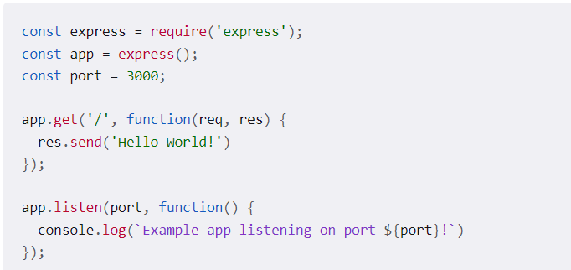
Hello world Express
The first two lines require() (import) the express module and create an Express application.
This object, which is traditionally named app, has methods for routing HTTP requests, configuring middleware, rendering HTML views, registering a template engine, and modifying application settings that control how the application behaves (e.g. the environment mode, whether route definitions are case sensitive, etc.)
The middle part of the code (the three lines starting with app.get) shows a route definition.

Slide 8
The app.get() method specifies a callback function that will be invoked whenever there is an HTTP GET request with a path ('/') relative to the site root.
The callback function takes a request and a response object as arguments, and calls send() on the response to return the string "Hello World!“
The final block starts up the server on a specified port ('3000') and prints a log comment to the console.
With the server running, go to localhost:3000 in the browser to see the example response returned.

Slide 9
Application Settings
The following table lists application settings.
Note that sub-apps will:
Not inherit the value of settings that have a default value.
Set the value in the sub-app.
Inherit the value of settings with no default value;
Exceptions: Sub-apps will inherit the value of trust proxy even though it has a default value (for backward-compatibility);
Sub-apps will not inherit the value of view cache in production (when NODE_ENV is “production”).

Slide 10
Importing and creating modules
A module is a JavaScript library/file that you can import into other code using Node's require() function.
Express itself is a module, as are the middleware and database libraries that we use in our Express applications.
How to import a module by name, using the Express framework as an example.
First we invoke the require() function, specifying the name of the module as a string ('express'), and calling the returned object to create an Express application. We can then access the properties and functions of the application object.
const express = require('express');
const app = express();
You can also create your own modules that can be imported in the same way.

Slide 11
To make objects available outside of a module you just need to expose them as additional properties on the exports object.
For example, the square.js module below is a file that exports area() and perimeter() methods:
exports.area = function(width) { return width * width; };
exports.perimeter = function(width) { return 4 * width; };
If you want to export a complete object in one assignment instead of building it one property at a time, assign it to module.exports .
You can also do this to make the root of the exports object a constructor or other function.
Example :
module.exports = {
area: function(width) {
return width * width;
},
perimeter: function(width) {
return 4 * width;
}
};

Slide 12
Using asynchronous APIs
JavaScript code frequently uses asynchronous rather than synchronous APIs for operations that may take some time to complete.
A synchronous API is one in which each operation must complete before the next operation can start.
For example, the following log functions are synchronous, and will print the text to the console in order (First, Second).
console.log('First');
console.log('Second');
By contrast, an asynchronous API is one in which the API will start an operation and immediately return (before the operation is complete). Once the operation finishes, the API will use some mechanism to perform additional operations.
For example, the code below will print out "Second, First" because even though setTimeout() method is called first, and returns immediately, the operation doesn't complete for several seconds.
setTimeout(function() {
console.log('First');
}, 3000);
console.log('Second');

Slide 13
Using non-blocking asynchronous APIs is even more important on Node than in the browser because Node is a single-threaded event-driven execution environment.
"Single threaded" means that all requests to the server are run on the same thread (rather than being spawned off into separate processes).
This model is extremely efficient in terms of speed and server resources, but it does mean that if any of your functions call synchronous methods that take a long time to complete, they will block not just the current request, but every other request being handled by your web application.
There are a number of ways for an asynchronous API to notify the application that it has completed.
The most common way is to register a callback function when you invoke the asynchronous API, that will be called back when the operation completes.

Slide 14
Creating route handlers
In our Hello World Express example we defined a (callback) route handler function for HTTP GET requests to the site root ('/').
app.get('/', function(req, res) {
res.send('Hello World!')
});
The callback function takes a request and a response object as arguments.
In this case, the method calls send() on the response to return the string "Hello World!"
There are a number of other response methods for ending the request/response cycle.
For example, you could call res.json() to send a JSON response or res.sendFile() to send a file.

Slide 15
The Express application object also provides methods to define route handlers for all the other HTTP verbs, which are mostly used in exactly the same way:
checkout(), copy(), delete(), get(), head(), lock(), merge(), mkactivity(), mkcol(), move(), msearch(), notify(), options(), patch(), post(), purge(), put(), report(), search(), subscribe(), trace(), unlock(), unsubscribe().
There is a special routing method, app.all(), which will be called in response to any HTTP method.
This is used for loading middleware functions at a particular path for all request methods.
The example shows a handler that will be executed for requests to /secret irrespective of the HTTP verb used (provided it is supported by the http module).
app.all('/secret', function(req, res, next) {
console.log('Accessing the secret section ...');
next(); // pass control to the next handler
});
Routes allow you to match particular patterns of characters in a URL, and extract some values from the URL and pass them as parameters to the route handler (as attributes of the request object passed as a parameter).

Slide 16
Often it is useful to group route handlers for a particular part of a site together and access them using a common route-prefix (e.g. a site with a Wiki might have all wiki-related routes in one file and have them accessed with a route prefix of /wiki/).
In Express this is achieved by using the express.Router object.
For example, can be created wiki route in a module named wiki.js, and then export the Router object:
// wiki.js - Wiki route module
const express = require('express');
const router = express.Router();
// Home page route
router.get('/', function(req, res) {
res.send('Wiki home page');
});
// About page route
router.get('/about', function(req, res) {
res.send('About this wiki'); });
module.exports = router;
To use the router in our main app file we would then require() the route module (wiki.js), then call use() on the Express application to add the Router to the middleware handling path. The two routes will then be accessible from /wiki/ and /wiki/about/.
const wiki = require('./wiki.js');
// ...
app.use('/wiki', wiki);

Slide 17
Express development environment?
The Express development environment includes an installation of Nodejs, the NPM package manager, and (optionally) the Express Application Generator on your local computer.
Node and the NPM package manager are installed together from prepared binary packages, installers, operating system package managers or from source .
Express is then installed by NPM as a dependency of your individual Express web applications (along with other libraries like template engines, database drivers, authentication middleware, middleware to serve static files, etc.)
NPM can also be used to (globally) install the Express Application Generator, a handy tool for creating skeleton Express web apps that follow the MVC pattern.
The application generator is optional because you don't need to use this tool to create apps that use Express, or construct Express apps that have the same architectural layout or dependencies.

Slide 18
Using NPM
Next to Node itself, NPM is the most important tool for working with Node applications.
NPM is used to fetch any packages (JavaScript libraries) that an application needs for development, testing, and/or production, and may also be used to run tests and tools used in the development process.
You can manually use NPM to separately fetch each needed package.
Instead manage dependencies using a plain-text definition file named package.json.
This file lists all the dependencies for a specific JavaScript "package“.
It is include:
package's name,
version,
description,
initial file to execute,
production dependencies, development dependencies, versions of Node it can work with, etc.
The package.json file should contain everything NPM needs to fetch and run your application

Slide 19
Adding dependencies
Steps show how use NPM to download a package, save it into the project dependencies, and then require it in a Node application.
1. Create a directory for the new application and navigate into it:
mkdir myapp
cd myapp
2. Use the npm init command to create a package.json file for your application.
This command prompts you for a number of things, including the name and version of your application and the name of the initial entry point file (by default this is index.js).
For now, just accept the defaults:
npm init
3. Install Express in the myapp directory and save it in the dependencies list of your package.json file
npm install express
dependencies section of your package.json will now appear at the end of the package.json file and will include Express.
4. Use the Express library you call the require() function in your index.js file to include it in your application
5. Start the server by calling node with the script in your command prompt:
>node index.js
Example app listening on port 3000
Navigate to the URL http://127.0.0.1:3000/

Slide 20
Views and Layouts
Express supports many different view engines that provide different levels of abstraction. Express gives some preference to a view engine called Jade .
The approach Jade takes is very minimal: what you write doesn’t resemble HTML at all, which certainly represents a lot less typing: no more angle brackets or closing tags. The Jade engine then takes that and converts it to HTML.
For this reasons it makes sense to use Handlebars (which is based on the popular language-independent templating language Mustache) doesn’t attempt to abstract away HTML for you: you write HTML with special tags that allow Handlebars to inject content.
npm install --save express3-handlebars
var app = express(); // set up handlebars view engine
var handlebars = require('express3-handlebars')
.create({ defaultLayout:'main' });
app.engine('handlebars', handlebars.engine);
app.set('view engine', 'handlebars');

Slide 21
Creating file called views/layouts/main.handlebars. Usual HTML with {{{body}}} . This expression will be replaced with the HTML for each view.
Result :
app.get('/', function(req, res) {
res.render('home');
});
app.get('/about', function(req, res) {
res.render('about');
});
// 404 catch-all handler (middleware)
app.use(function(req, res, next){
res.status(404);
res.render('404');
});
// 500 error handler (middleware)
app.use(function(err, req, res, next){
console.error(err.stack);
res.status(500);
res.render('500'); });
The view engine will return a content type of text/html and a status code of 200 by default. In the catchall handler, which provides our custom 404 page, and the 500 handler, we have to set the status code explicitly.

Slide 22
Creating a basic website
The Express Application Generator allows you to configure a number of popular view/templating engines (although it chooses Jade by default if you don't specify a view option).
Express itself can also support a large number of other templating languages.
Some of the things to consider when comparing template engines:
Time to productivity — If your team already has experience with a templating language then it is likely they will be productive faster using that language. If not, then you should consider the relative learning curve for candidate templating engines.
Popularity and activity — Review the popularity of the engine and whether it has an active community. It is important to be able to get support when problems arise throughout the lifetime of the website.
Style — Some template engines use specific markup to indicate inserted content within "ordinary" HTML, while others construct the HTML using a different syntax (for example, using indentation and block names).
Performance/rendering time.

Slide 23
Consider as well the following features available:
Layout inheritance: Allows you to define a base template and then "inherit" just the parts of it that you want to be different for a particular page. This is typically a better approach than building templates by including a number of required components or building a template from scratch each time.
"Include" support: Allows you to build up templates by including other templates.
Concise variable and loop control syntax.
Ability to filter variable values at template level (e.g. making variables upper-case, or formatting a date value)
Ability to generate output formats other than HTML (e.g. JSON or XML).
Support for asynchronous operations and streaming.
Client-side features. If a templating engine can be used on the client this allows the possibility of having all or most of the rendering done client-side.

Slide 24
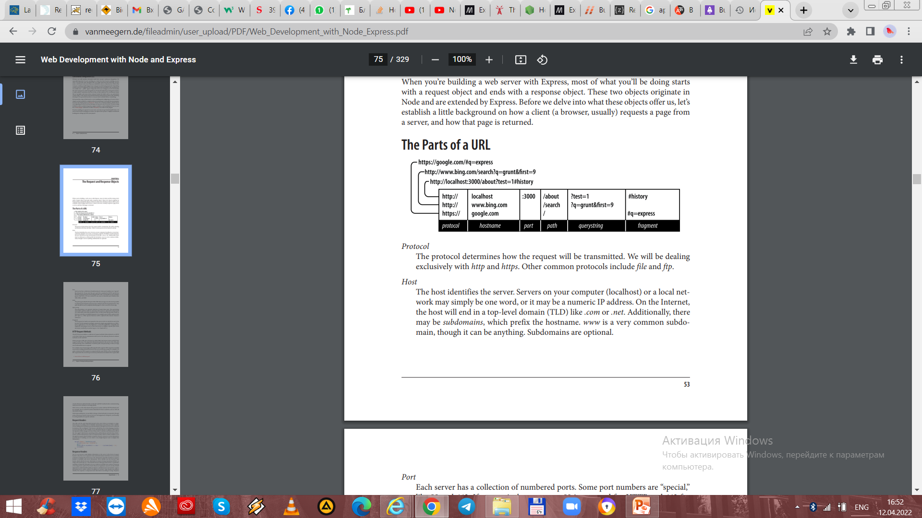
The Parts of a URL
Protocol The protocol determines how the request will be transmitted. We will be dealing exclusively with http and https. Other common protocols include file and ftp.
Host The host identifies the server. Servers on your computer (localhost) or a local net‐ work may simply be one word, or it may be a numeric IP address. On the Internet, the host will end in a top-level domain (TLD) like .com or .net.
Port Each server has a collection of numbered ports. Some port numbers are “special,” like 80 and 443. If you omit the port, port 80 is assumed for HTTP and 443 for HTTPS. In general, if you aren’t using port 80 or 443, you should use a port number greater than 1023.1 It’s very common to use easy-to-remember port numbers like 3000, 8080, and 8088.
Path The path is generally the first part of the URL that your app cares about (it is possible to make decisions based on protocol, host, and port, but it’s not good practice). The path should be used to uniquely identify pages or other resources in your app
Querystring The querystring is an optional collection of name/value pairs. The querystring starts with a question mark (?), and name/value pairs are separated by ampersands (&). Both names and values should be URL encoded. JavaScript provides a built-in function to do that:
encodeURIComponent. For example, spaces will be replaced with plus signs (+)
Fragment The fragment (or hash) is not passed to the server at all: it is strictly for use by the browser. It is becoming increasingly common for single-page applications to use the fragment to control the application. Originally, the fragment’s sole purpose was to cause the browser to display a specific part of the document, marked by an anchor tag ()

Slide 25
HTTP Request Methods
The HTTP protocol defines a collection of request methods that a client uses to communicate with a server.
The most common methods are GET and POST. When you type a URL into a browser (or click a link), the browser issues an HTTP GET request to the server.
The important information passed to the server is the URL path and querystring. The combination of method, path, and querystring is what your app uses to determine how to respond.
For a website, most of your pages will respond to GET requests.
POST requests are usually reserved for sending information back to the server (form processing, for example). It’s quite common for POST requests to respond with the same HTML as the corresponding GET request after the server has processed any information included in the request.
Browsers will exclusively use the GET and POST methods when communicating with your server (if they’re not using AJAX). Web services, on the other hand, often get more creative with the HTTP methods used. For example, there’s an HTTP method called DELETE that is useful for, well, an API call that deletes things.
With Node and Express, you are fully in charge of what methods you respond to. In Express, you’ll usually be writing handlers for specific methods.

Slide 26
Node.js Express Back-end
Methods | Urls | Actions
GET | api/authors | get all Authors
GET | api/authors/:id | get Authors by id
POST | api/authors | add new Author
PUT | api/authors/:id | update Author by id
DELETE | api/authors/:id | remove Author by id
DELETE | api/authors | remove all Authors
GET | api/authors?title=[kw] | find all Authors which title contains 'kw

Slide 27
Request Headers
The URL isn’t the only thing that’s passed to the server when you navigate to a page. Your browser is sending a lot of “invisible” information every time you visit a website. The browser will tell the server what language it prefers to receive the page in.
It will also send information about the “user agent” (the browser, operating system, and hardware) and other bits of information.
All this information is sent as a request header, which is made available to you through the request object’s headers property.
Example:
Express route to display information browser is sending
app.get('/headers', function(req,res){
res.set('Content-Type','text/plain');
var s = '';
for(var name in req.headers) s += name + ': ' + req.headers[name] + '\n'; res.send(s);
});

Slide 28
Response Headers
Just as your browser sends hidden information to the server in the form of request headers, when the server responds, it also sends information back that is not necessarily rendered or displayed by the browser.
The information typically included in response headers is metadata and server information.
Headers can indicate whether the response is compressed and what kind of encoding it’s using.
It is also common for response headers to contain some information about the server, indicating what type of server it is, and sometimes even details about the operating system

Slide 29
The Request Object
List of the most useful properties and methods of the request object:
req.params An array containing the named route parameters.
req.param(name) Returns the named route parameter, or GET or POST parameters.
req.query An object containing querystring parameters (sometimes called GET parameters) as name/value pairs.
req.body An object containing POST parameters. It is so named because POST parameters are passed in the body of the REQUEST, not in the URL like querystring parameters.
req.route Information about the currently matched route. Primarily useful for route debugging.
req.cookies/req.signedCookies- Objects containing containing cookie values passed from the client
req.headers The request headers received from the client.
req.accepts([types]) A convenience method to determine whether the client accepts a given type or types.This method is of primary interest to those writing public APIs; it is assumed that browsers will always accept HTML by default.

Slide 30
req.ip The IP address of the client
req.path The request path (without protocol, host, port, or querystring)
req.host A convenience method that returns the hostname reported by the client. This in‐ formation can be spoofed and should not be used for security purposes.
req.xhr A convenience property that returns true if the request originated from an AJAX call
req.protocol The protocol used in making this request (for our purposes, it will either be http or https).
req.secure A convenience property that returns true if the connection is secure. Equivalent to req.protocol==='https'.
req.url/req.originalUrl A bit of a misnomer, these properties return the path and querystring (they do not include protocol, host, or port).
req.url can be rewritten for internal routing purposes, but req.originalUrl is designed to remain the original request and querystring.
req.acceptedLanguages A convenience method that returns an array of the (human) languages the client prefers, in order. This information is parsed from the request header.

Slide 31
The Response Object
The response object (which is normally passed to a callback, meaning you can name it whatever you want: it is common to name it res, resp, or response) starts its life as an instance of http.ServerResponse, a core Node object.
res.status (code) Sets the HTTP status code. Express defaults to 200 (OK), so you will have to use this method to return a status of 404 (Not Found) or 500 (Server Error), or any other status code you wish to use. For redirects (status codes 301, 302, 303, and 307), there is a method redirect, which is preferable.
res.set(name, value) Sets a response header
res.cookie(name, value, [options]), res.clearCookie(name, [options]) Sets or clears cookies that will be stored on the client.
res.redirect([status], url) Redirects the browser. The default redirect code is 302 (Found). In general, you should minimize redirection unless you are permanently moving a page, in which case you should use the code 301 (Moved Permanently).
res.send(body), res.send(status, body) Sends a response to the client, with an optional status code. Express defaults to a content type of text/html, so if you want to change it to text/plain, you’ll have to call res.set('Content-Type', 'text/plain\') before calling res.send. If body is an object or an array, the response is sent as JSON instead (with the content type being set appropriately), though if you want to send JSON, call res.json instead.
res.json(json), res.json(status, json) Sends JSON to the client with an optional status code. res.jsonp(json), res.jsonp(status, json) Sends JSONP to the client with an optional status code.

Slide 32
res.type(type) A convenience method to set the Content-Type header. Essentially equivalent to res.set('Content-Type', type), except that it will also attempt to map file ex‐ tensions to an Internet media type if you provide a string without a slash in it.
res.format(object) This method allows you to send different content depending on the Accept request header.
res.attachment([filename]), res.download(path, [filename], [callback]) Both of these methods set a response header called Content-Disposition to at tachment; this will prompt the browser to download the content instead of dis‐ playing it in a browser. You may specify filename as a hint to the browser. With res.download, you can specify the file to download, whereas res.attachment just sets the header; you still have to send content to the client.
res.sendFile(path, [options], [callback]) This method will read a file specified by path and send its contents to the client. There should be little need for this method; it’s easier to use the static middleware, and put files you want available to the client in the public directory.
res.links(links) Sets the Links response header. This is a specialized header that has little use in most applications.
res.locals, res.render(view, [locals], callback) res.locals is an object containing default context for rendering views. res.ren der will render a view using the configured templating engine (the locals param‐ eter to res.render shouldn’t be confused with res.locals: it will override the context in res.locals, but context not overridden will still be available).

Slide 33
API (application programming interface)
An API, also known as an application programming interface, is a set of protocols and definitions that can allow one application to interact with another application. It is a computational interface that is used to determine the interaction between various software intermediaries.
It will determine the types of requests and calls that can be made. It is an information gateway that will allow software and services to interact with each other.
Automation. APIs can allow you to manage your tasks through computers rather than using human power to do so. APIs can help agencies update their workflows to become faster and more productive in the best possible way.It can help you automate manual tasks to ensure an easy and smooth transition between related applications.
Setup is easier. APIs allow users to customize their services according to their needs. Users will be able to add or remove features or analyze data according to their requirements. With the help of APIs, you can make an individual suit for yourself, which can be modified or changed if necessary.
Flexible information delivery. APIs can access application components. Consequently, it can make the provision of information and services more flexible and faster.
Easier integration . API is the best way to embed or integrate services for other platforms. The API can allow different applications, systems and platforms to interact and exchange information with each other to easily perform different types of tasks. This is very effective for more efficient optimization of specific processes.
Here are the three most common API protocols:
SOAP
REST
GraphQL

Slide 34
SOAP
SOAP also means a simple object access protocol and is probably better known among other protocols.
However, it is basically a messaging protocol known for altering structured information in the implementation of computer network web services.
The purpose of SOAP is to provide neutrality, extensibility, independence and verbosity.
This protocol mainly relies on XML along with schemas that define it as a very strongly typed protocol for messaging.
Each operation that will be defined by this service is explicitly defined along with an XML-based request and response structure for a specific operation.
Each input parameter here is bound and defined for a type such as a string, an integer, or any other complex object.
SOAP helps developers to call processes running on various operating systems, such as Linux, macOS, Windows, etc., for authorization, authentication and interaction with XML (Extensible Markup Language).
Web protocols such as HTTP work on almost all operating systems; hence SOAP also allows its clients to call web services and receive responses regardless of platforms and languages.

Slide 35
REST
REST API means the transfer of a representative state, an architectural style for distributed hypermedia systems. Like other architectural styles, the REST API also has its own limitations.
There are six main limitations about the REST API:
1.It separates user interface issues and data storage issues to improve the portability of the user interface across multiple platforms. It also helped to increase scalability by simplifying server components.
2.Each server for a client request should contain all the necessary information to facilitate understanding of the request. However, the session state will be fully stored on the client.
3. According to caching restrictions, the data in the request-response must be marked as cached or non-cached.
4. A single interface simplifies the overall architecture of the system, improving the visibility of interaction. While REST is defined by four interface constraints, including resource identification, resource manipulation via hypermedia representations as an application statistics mechanism, and self-descriptive messages.
5.A multi-level system is designed so that the architecture can consist of hierarchical levels with restrictions on the behavior of components. At the same time, each component can see in the layer with which it interacts.
6.The REST API allows you to extend the functionality of the client by downloading and executing code in the form of applets and scripts.

Slide 36
GraphQL
GraphQL is a fantastic query language for the API, allowing you to perform these queries using existing data.
It can offer you a clear but complete description of the data in your API.
1.You can send GraphQL queries to the API to get exactly what you want to know. These queries always return predictable results.
2. GraphQL-based applications are usually faster and more stable because they do not control the data that these applications receive.
3. These requests will not only access the properties of resources, but also smoothly follow the links between them.
4. GraphQL queries can deliver all the data you need in just one query.
5. These APIs used to work faster even with a slow internet connection.
6. These APIs are organized by fields and types, not by endpoints.

Slide 37
Web service
A web service is, in fact, a piece of software available over the Internet that uses a standardized XML messaging system.
The web service encodes all messages via XML.
This is a service that offers communication between different devices via WWW.
Web technology, like HTTP, is used to transmit a machine-readable file format in a web service such as JSON and XML.
In practice, a web service provides an object-oriented web interface for a database server used by any other web server or mobile application that provides a user interface for the end user.
To allow syndication, many companies that provide data or information in formatted HTML pages will also provide data in JSON or XML format on their servers.

Slide 38
Difference between an API and a Web service
The main difference between these two :
The API acts as an interface between different applications, allowing them to interact with each other in a more efficient way.
A web service is designed to facilitate communication between two devices or machines over a network.
However, other differences between the API and the web service are :
All web services can be used as an API, while you cannot use every API as a web service.
The web service cannot perform all the operations that you can do using the API.
The API can use any communication style.
The web service always requires a network connection for normal operation, but the API does not.
APIs usually contain interfaces and classes, just like a program.
The API can help programmers establish communication between different software applications.

Slide 39
REST API
REST (Representational State Transfer) is a standard architecture for building and communicating with web services.
It typically mandates resources on the web are represented in a text format (like JSON, HTML, or XML) and can be accessed or modified by a predetermined set of operations.
Given that we typically build REST APIs to leverage with HTTP instead of other protocols, these operations correspond to HTTP methods like GET, POST, or PUT.
On a collection of data, like books for example, there are a few actions we'll need to perform frequently, which boil down to - Create, Read, Update and Delete (also known as CRUD Functionality).
An API, as the name suggests, is an interface that defines the interaction between different software components.
Web APIs define what requests can be made to a component (for example, an endpoint to get a list of books), how to make them (for example, a GET request), and their expected responses.

Slide 40
There are a few types of HTTP methods that we need to grasp before building a REST API.
These are the methods that correspond to the CRUD tasks:
POST: Used to submit data, typically used to create new entities or edit already existing entities.
GET: Used to request data from the server, typically used to read data.
PUT: Used to completely replace the resource with the submitted resource, typically used to update data.
DELETE: Used to delete an entity from the server.

Slide 41
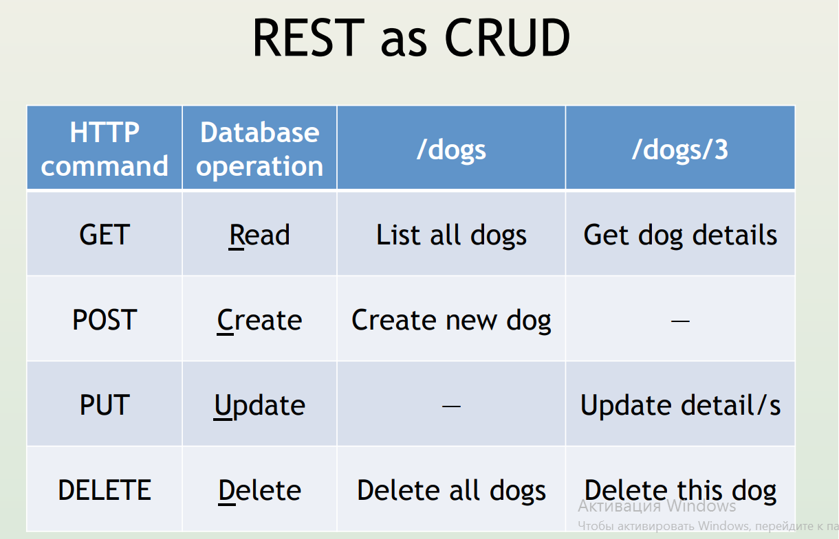

Slide 42
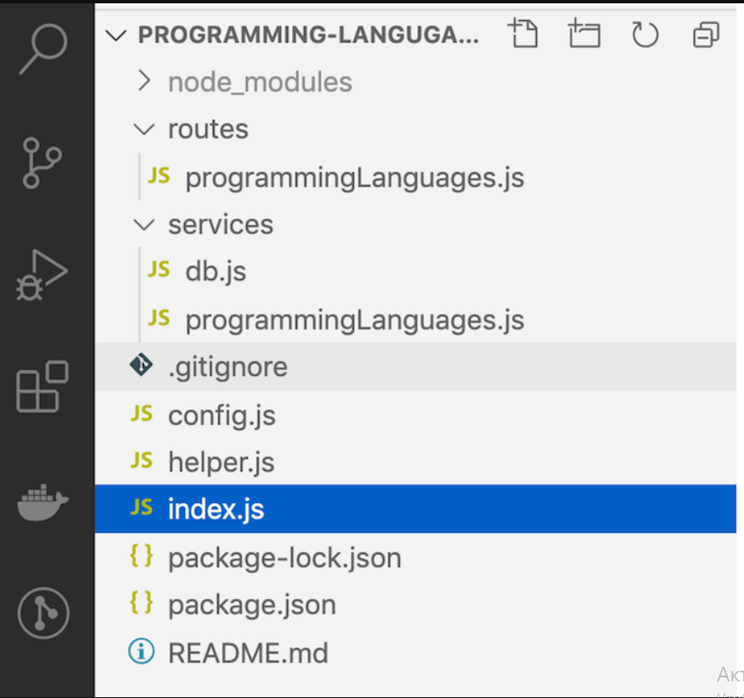
REST API project structure
config.js will contain configuration for information like the database credentials and the rows we want to show per page when we paginate results.
helper.js is the home for any helper functions, like calculating offset for pagination.
The routes/programmingLanguages.js file will act as the glue between the URI and the corresponding function in the services/programmingLanguages.js service.
The services folder will house all our services. One of them is db.js, which used to talk with the MySQL database.

Slide 43
Initialize a new app.
There are few ways to initialize a new express app.
1. Creating the files by hand.
A basic Node app contains a .js file and a package.json file.
The package.json file contains a couple of properties.
First one is name which holds the name of the app, second is version which shows the version of your app, a description of your app, main that points to the entry point of your application.
There’s also scripts, that can be run when you need to perform some repetitive tasks, author name, licence, dependencies and devDependencies.
2. The package.json describes the app. When uploading your app, your dependencies will be listed avoiding duplication and excessive data transfer.
3. Use the npm tool. All you have to do is open up your cmd in the folder you want to create your app in and type npm init to interactively create your package.json file.

Slide 44
Installing Express.
Use the second method to generate a package.json file almost similar to the one pictured above. Second thing we want to do is install Express into our app.
Note, no need to install express globally (-g) if we need to use it in this specific folder/app. Use the command below to install Express.
npm install express –save
The save flag is used to edit your package.json file and add express as a dependency.
After the installation is complete, open up your package.json to see express listed as a dependency.
With this, you could send just your code and package.json file to a friend and request them to use npm to install the dependencies on their computer saving you some amount of data.
To install, your friend will have to open up cmd inside the app folder and use the command npm install.

Slide 45
Creating the app.
Create the app.js file or whatever you prefer naming it (default is index.js) and add in the code.
var express = require("express"); var app = express();app.listen(3000, () => { console.log("Server running on port 3000"); });
1. The first line requires express and uses the express variable to represent it.
2. The second line initialized express using the brackets which initializes an express server and puts the initialized server into the variable app.
Whenever we want to use our express server, we would need to use the app variable which represents our app.
3. We then set our app to listen to port 3000 and create a callback function that says our server is running on port 3000.

Slide 46
Setting request handlers.
A server receives requests, processes them and returns a response.
You need to use routes to handle this requests. T
he requests have three major types, a GET request that get’s data, a POST request that sends data securely, a PUT request that updates data and a DELETE request that deletes data.
In a Web API, a server receives a request through a URL endpoint and sends a response in return, which is often data in a format such as JSON.
app.get("/url", (req, res, next) => { res.json(["Tony","Lisa","Michael","Ginger","Food"]); });
This simple function makes the express app to use the url handle “/url” to trigger the callback that follows it.
The callback accepts three parameters, req is the request body and carries information about the request.
The res is the response body and is used to handle response functions like .render() to render templates and .json() to return json data.

Slide 47
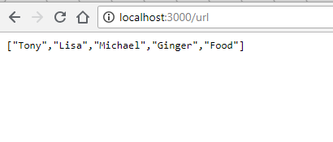
Running your app.
To run your app, use:
node app.js
To view our data, open up your browser and enter http://localhost:3000/url.

Slide 48
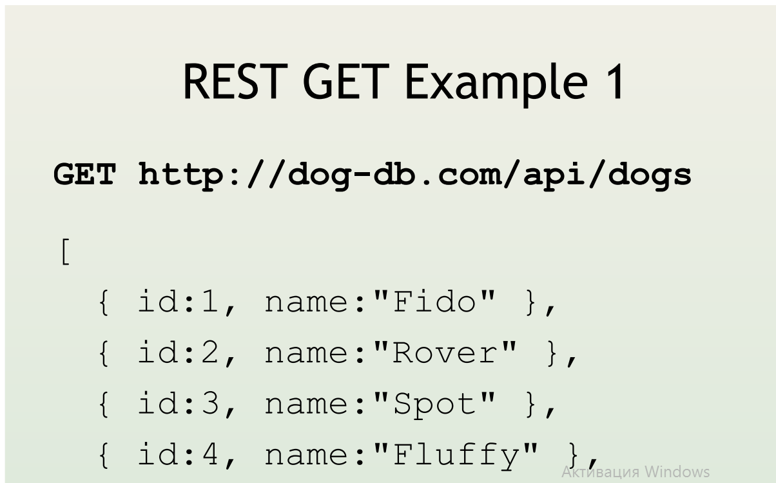

Slide 49
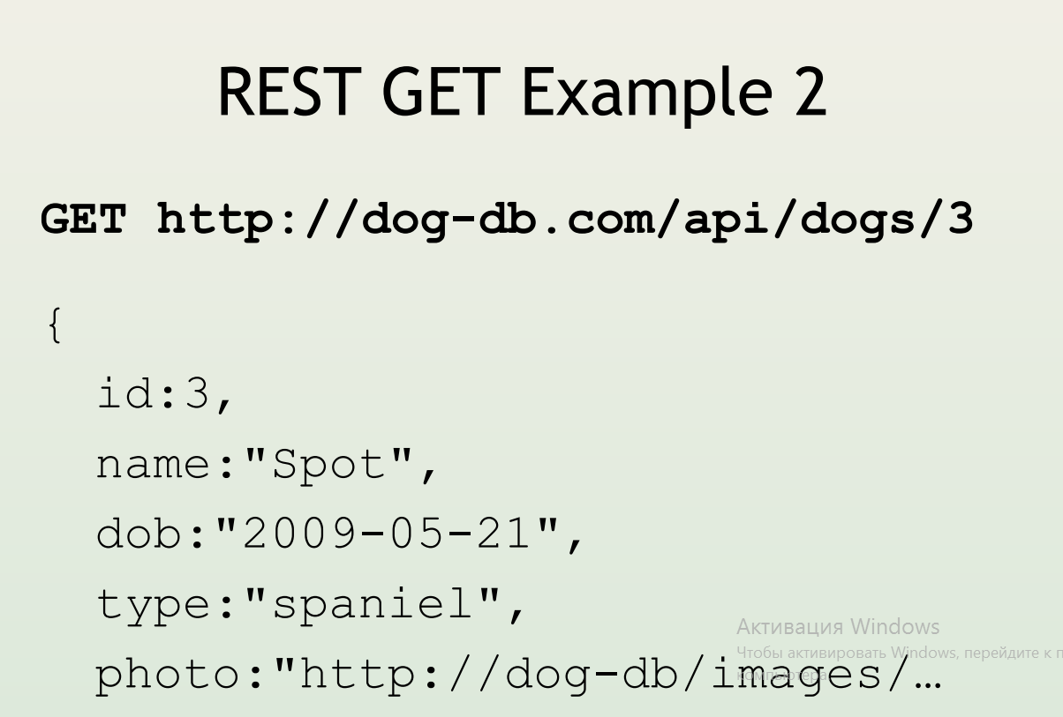

Slide 50
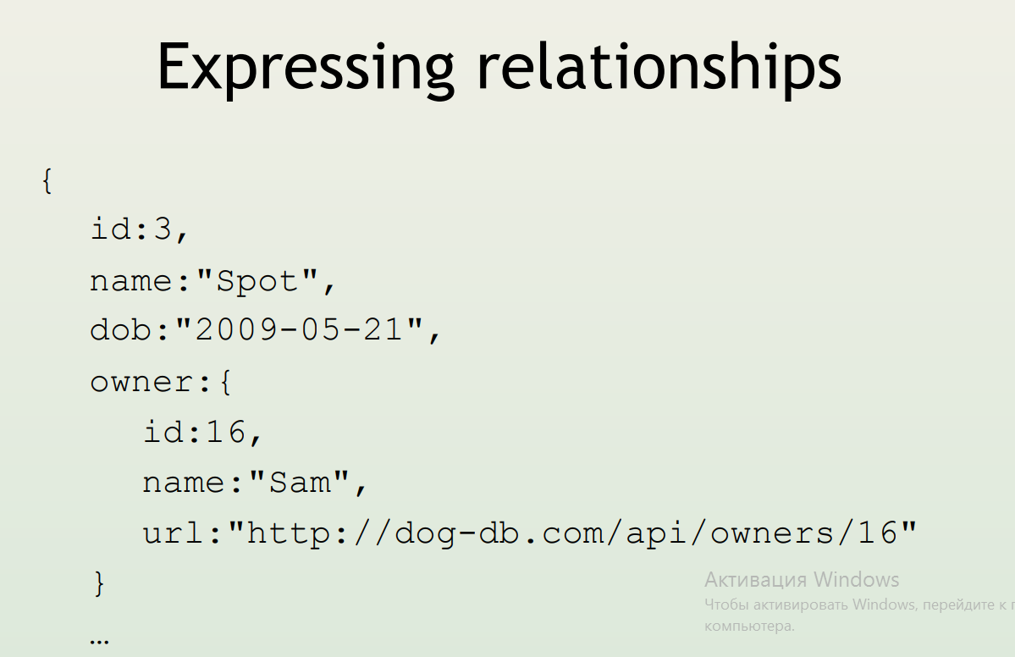

Slide 51
